Slide 1

INTEGRATED FACE DETECTION AND TIME-STAMPED ATTENDANCE MONITORING
by
Manoj Kumar K
Roll No. 224G5A3308
Shameer S
Roll No. 224G5A3311
Ramana N
Roll No. 214G1A3387
Yashoda Krishna K
Roll No. 214G1A33C8
Under the guidance of
Mr . G . Ganesh M.Tech
Assistant Professor
Assistant Professor
Department of Computer Science and Engineering(A&ML)
Srinivasa Ramanujan Institute of Technology
Autonomous
Rotarypuram Village, B K Samudram Mandal, Ananthapuramu – 515701.
2024-2025

Slide 2

Contents
Abstract
Introduction
Literature Survey
Existing System
Proposed System
Planning and Design
Methodology
Implementation
Results
Conclusion & Future Works
Published Paper status
References

Slide 3
Abstract
Using technology for attendance systems is usually time-consuming and error-prone. Managing students and entering data of bulk students can be a time-consuming process and prone to data entry errors. In this purpose, we have designed a System to integrate face Detection and time-stamped based system which makes use of face detection and face recognition techniques to avoid the manual way of data entry. For face detection, we use HOG + SVM or CNN and for face recognition, we use Deep Metric Learning (ResNet-34). It performs a face matching using Euclidean distance-based face matching to the match detected faces to a database of stored faces thus producing a very good accuracy of face identification. This model is implemented in Python using openCV and face_recognition libraries. In addition, it implements an auto attendance mechanism by using the OpenPyXL library to input real time data into an Excel sheet. GUI based on Tkinter is included to improve usability, monitor attendance in real-time and track attendance. This flawless and secure identification makes the system a good recommendation for schools, organizations, and access control. This solution replaces manual entry of attendance therefore making attendance more efficient and minimizing errors while providing a practical output and automatic way of addressing attendance issues for different scenarios.
Keywords: HOG, SVM, CNN, ResNet-34, Euclidean Distance, KNN, OpenPYXZ.

Slide 4
Introduction
Face recognition has rapidly evolved into an essential technology across various fields, including security, authentication, and attendance management.
Unlike traditional methods, which rely on ID cards or fingerprint scans, face recognition provides a fast, accurate, and non-intrusive way to identify individuals.
raditional attendance marking methods, such as manual entry or fingerprint-based systems, have several limitations, including errors, fraud (proxy attendance), and inefficiencies.
A face recognition-based attendance system eliminates these issues by automating the process and improving accuracy.
Types of Face Recognition Processes
Verification (One-to-One Matching): Compares a detected face with a single stored face for authentication (e.g., unlocking devices).
Identification (One-to-Many Matching): Matches a face against a database of faces, which is essential for attendance automation and security monitoring.

Slide 5
Contd…
The system works in multiple stages: Face Detection: Identifies a face in an image or video stream. Feature Extraction: Extracts key facial features such as eyes, nose, and jawline. Face Encoding: Converts these features into a mathematical format for easy identification. Face Recognition & Matching: Compares the detected face with stored database entries and marks attendance automatically. The system updates attendance records in real-time by recognizing faces and storing the data in an Excel sheet or database. It eliminates the need for manual intervention, making the process faster and more reliable.

Slide 6
Literature survey
Face Recognition-Based Attendance Monitoring System Using Raspberry Pi and OpenCV
Authors: Omkar Biradar, Anurag Bhave (2019)
This system is designed to automate attendance marking using Raspberry Pi and OpenCV. A camera captures images of individuals (students/employees), detects faces, and compares them with stored records in a database.
The process consists of two main phases:
Pre-detection: Face detection and alignment.
Post-detection: Feature extraction and matching to verify identity.
Image normalization techniques improve accuracy. Attendance is then updated on a web interface, making tracking and monitoring easier.

Slide 7
Literature survey
Automated Attendance System Using Face RecognitionAuthors: Akshara Jadhav, Akshay Jadhav, Tushar Ladhe, Krishna Yeolekar (2017)
This study focuses on a real-time face recognition system that marks attendance as students enter a classroom. It improves security and efficiency by eliminating manual roll calls.
The system uses Principal Component Analysis (PCA), a machine learning technique that helps improve recognition accuracy while reducing false positives.
A major challenge is limited recognition ability when students change their appearance (e.g., hairstyle, beard). Additionally, it can only recognize faces within a 30-degree angle variation, making it less flexible in dynamic environments.

Slide 8
Literature survey
Face Recognition-Based Attendance Marking SystemAuthors: Senthamil Selvi, Chitrakala, Antony Jenitha (2014)
The study proposes an automated attendance system that captures, detects, and authenticates faces using a database.One major advantage is secure storage of attendance data on a server, reducing risks of manipulation or proxy attendance.
The system enhances face detection accuracy using skin classification techniques.
However, a limitation is that it is not portable and requires a continuous power supply and a standalone computer, making it less practical for students who attend multiple sessions in a day.

Slide 9
Literature survey
Implementation of an Automated Attendance System Using Face RecognitionAuthors: Mathana Gopala Krishnan, Balaji, Shyam Babu (2015)
The study presents a time-efficient and automated attendance system designed for educational institutions.
The system uses the Eigenface approach, a technique based on eigenvectors, to analyze and classify facial features.
Attendance is marked within a predefined time frame, and after that, the session closes automatically.
If an unidentified face appears multiple times, the system adapts and learns to recognize it over time, improving accuracy.
Additionally, it generates a list of absentees, making it easier for institutions to monitor attendance records.

Slide 10
Existing System
The existing system for attendance tracking typically relies on manual methods such as roll calls or swipe cards, which are time-consuming and prone to errors.
While some automated systems use RFID or barcode scanning, these methods still require physical interaction, making them less efficient.
Face recognition-based attendance systems, although available, often face limitations in accuracy, especially under varying lighting conditions and multiple face detections.
Additionally, integration with existing systems, such as real-time logging and managing large datasets, remains a challenge.
These systems may also lack advanced features such as live monitoring and user-friendly interfaces for administrators.

Slide 11
Proposed System
The proposed Face Recognition-based Attendance Management System leverages advanced computer vision and machine learning algorithms to automate the attendance tracking process, ensuring greater accuracy and efficiency.
The system begins with capturing real-time images or video of individuals entering the room using a camera.
The face detection module processes each frame, detecting faces and extracting key facial features. These features, such as the position of the eyes, nose, and jawline, are then encoded into a numerical representation called face encodings. The system stores these encodings in a database for future comparison.
When a new individual enters, the system compares the live face data with the pre-stored database to check for a match. If a match is found, the system automatically marks attendance by logging the individual’s details—name, date, and time—into a secure database or Excel sheet. This reduces the potential for manual errors, proxy attendance, and data manipulation.

Slide 12
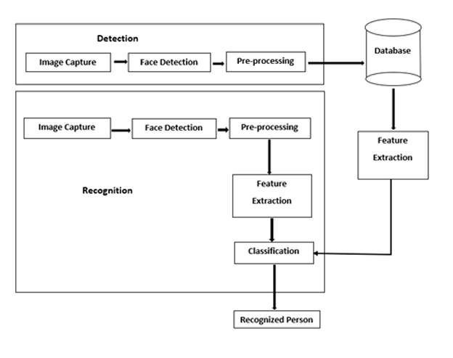
Proposed System
The system is modular and scalable, allowing easy updates and integration with other platforms. A user-friendly interface is provided, making it easy for administrators to manage registrations and monitor attendance. The system emphasizes accuracy, speed, and security, making it an ideal solution for schools, colleges, and workplaces looking to automate and streamline attendance management.
Figure : Proposed Work Architecture

Slide 13
Planning
Objectives:
Automated Attendance Tracking: Create a system that automatically records who is present using face recognition, so there's no need for someone to manually mark attendance.
Real-time Face Recognition: Build a system that can instantly recognize faces, even when lighting or the angle of the face changes.
Scope:
The scope of this project is to develop an automated face recognition-based attendance system. It involves capturing real-time images, processing faces, and comparing them with stored data to mark attendance. The system will be efficient, scalable, and easy to integrate, suitable for educational institutions and workplaces.

Slide 14
Planning
Functional Requirements:
The system should be able to capture real-time images or video frames using a camera to
detect faces.
The system must identify and locate faces in the captured image/video using face detection algorithms.
The system must compare detected faces with pre-stored data to recognize individuals.
The system should automatically mark attendance when a recognized face is detected, logging details like name, date, and time.
Non functional Requirements:
Performance
Scalability
Accuracy

Slide 15
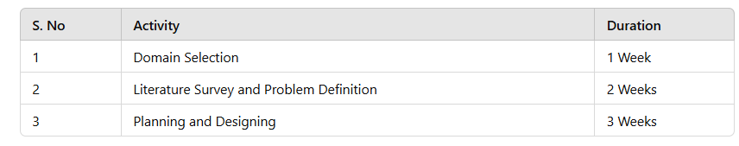
Planning
Time Estimation:
Basically our project is divided into two phases:
Phase-1:Pre-requisites, Planning and Designing
Table : Activities performed in Phase-1

Slide 16
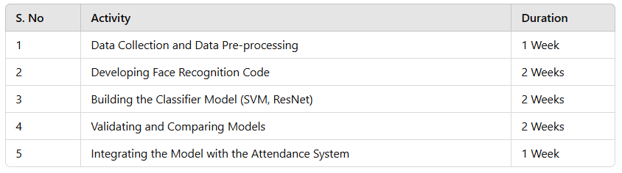
Planning
Phase-2: Developing the Model
Table: Activities Performed in Phase 2

Slide 17
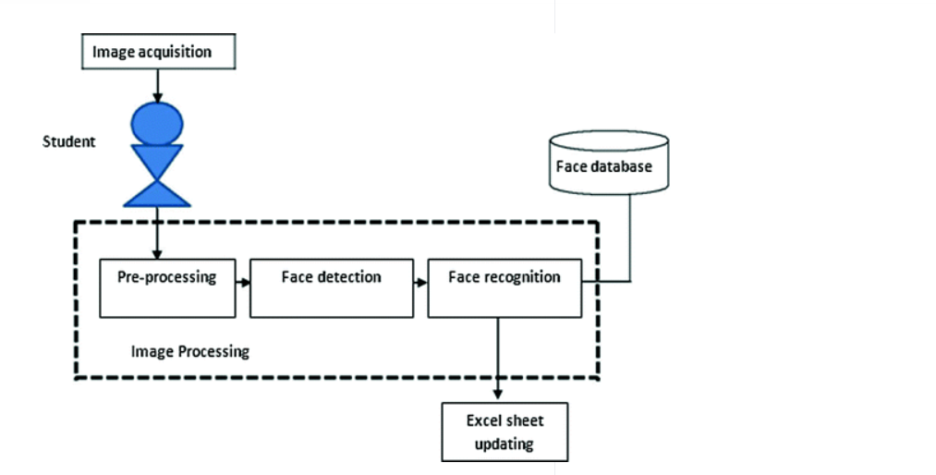
Designing
Figure : Block diagram of Proposed System

Slide 18
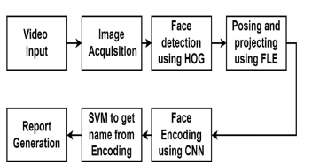
Designing
Figure : System Flow Diagram

Slide 19
Hardware & Software Requirements
Requirement Specification:
Hardware Requirements:
System Processor : Intel I3
Hard Disk : 500 GB
Ram : 4 GB
Software Requirements:
Operating system : Windows OS 8
Coding Language : Python
Software : Anaconda
IDE : Jupyter Notebook

Slide 20
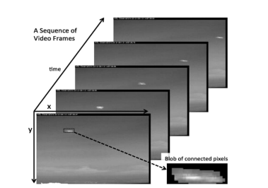
Methodology
Data Acquisition: This step involves collecting images or video frames using a camera. It’s important to capture images under various conditions (e.g., different lighting, angles, and facial expressions) to ensure the system can recognize faces in diverse real-world environments. The images are labeled with the individual's identity and stored in a database for later use.
Figure : Image Acquisition

Slide 21
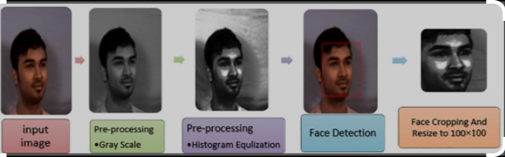
Contd…
Pre-processing: Pre-processing prepares the images for recognition by improving image quality and standardizing them. This includes converting images to grayscale to reduce complexity, resizing them to uniform dimensions, normalizing the brightness using histogram equalization, and removing noise to ensure the system can focus on important features of the face.
Figure : Converting images to grayscale

Slide 22
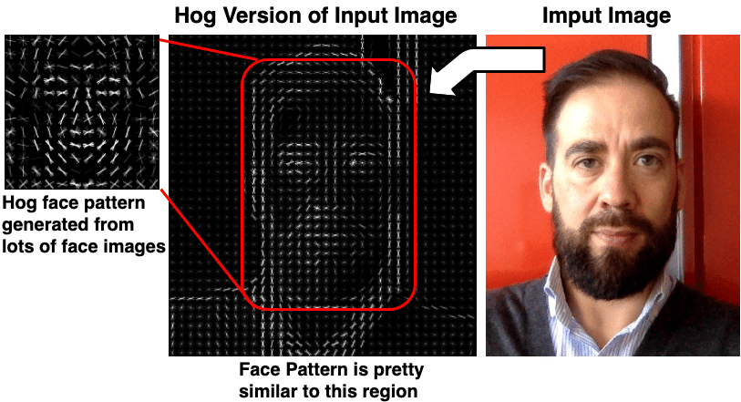
Contd…
Face Detection Using HOG and SVM: This process detects faces within an image. The Histogram of Oriented Gradients (HOG) extracts edge and gradient information, while the Support Vector Machine (SVM) classifies the detected face from the background. This step helps the system focus on faces, eliminating unnecessary information in the image.
Table : Face Detection Using HOG and SVM

Slide 23
Contd…
Possible use cases for hog face recognition
Access management using face recognition.
Near-range scenarios involving distances of 5 to 6 feet between the camera and the face of the person to be recognized.
Successful recognition is restricted to 15 degrees of freedom in pitch, yaw, and roll for the face.
The entire face recognition solution is divided into following major modules:
Face Capture
Face Train
Face Recognition

Slide 24
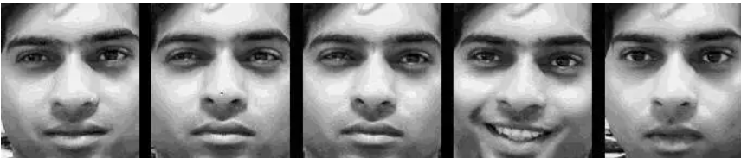
Contd…
Face Capture
How does face recognition work? The very first step in face recognition is to collect face samples. This is carried out in three basic steps as follows:
Detect the face.
Crop the cardinal section of the face.
Save the face image.
Figure : Sample face capture (Source: eInfochips)

Slide 25
Contd…
Face Train
In this stage, features from images associated with each person are gathered. Later, a complete set of information from all of the stored images, isolated per person as a single SVM label, is trained to generate an SVM model.
What are Support Vector Machines (SVMs)?
Support vector machines (SVMs) are supervised machine learning models that divide and classify data.
SVMs are widely used for applications such as face detection, classification of images, handwriting recognition, etc. An SVM model can be considered as a point space wherein multiple classes are isolated using hyperplanes.

Slide 26
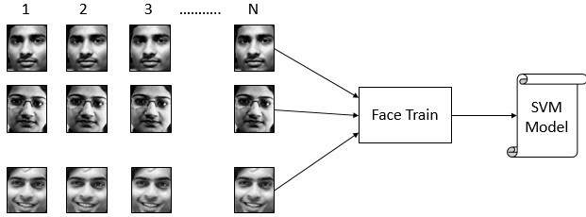
Contd…
Figure : Block diagram of face training (Source: eInfochips)

Slide 27
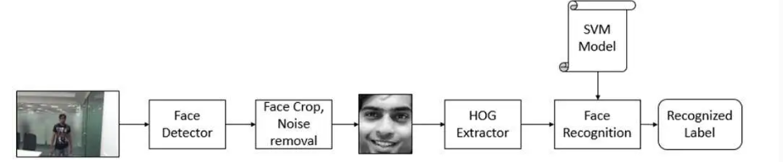
Contd…
Face Recognition
The recognition of a face in a video sequence is split into three primary tasks: Face Detection, Face Prediction, and Face Tracking. The tasks performed in the Face Capture program are performed during face recognition as well. To recognize the face obtained, a vector of HOG features of the face is extracted. This vector is then used in the SVM model to determine a matching score for the input vector with each of the labels. The SVM returns the label with the maximum score, which represents the confidence to the closest match within the trained face data.
Figure : Block diagram of the face recognition process (Source: eInfochips)

Slide 28
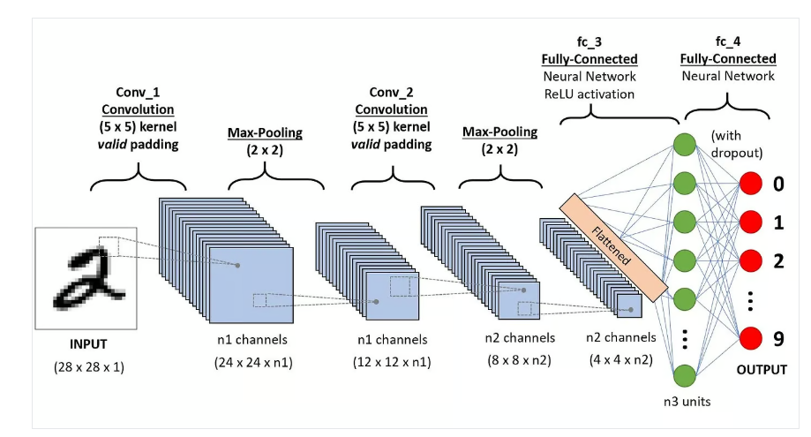
Contd…
Feature Extraction and Encoding Using ResNet-34: Once a face is detected, it is processed using ResNet-34, a deep learning model that extracts detailed features from the face. These features are encoded into a numerical vector (embedding) that uniquely represents the face, enabling the system to recognize individuals even in varying conditions like lighting or facial expressions.
Figure : Feature Extraction and Encoding Using ResNet-34

Slide 29
Contd…
Face Matching: The feature vectors (encodings) of detected faces are compared to a database of stored face embeddings using Euclidean distance. If the distance is small, the system recognizes the face as a match. If it's large, the system considers the face unknown. The matching process helps identify individuals for attendance logging.
Attendance Logging: Once a match is confirmed, the system automatically logs the individual’s attendance by recording their name, ID, and the time of recognition. This information is saved securely in a database or spreadsheet, providing an efficient, automated way to track attendance in real-time.

Slide 30
Implementation
Implementation of the Face Recognition-based Attendance System
Basic implementation of a Face Recognition-based Attendance System using Python, OpenCV, and a machine learning model for face recognition.
Requirements:
Python: Programming language.
OpenCV: For handling image capture and processing.
dlib or face_recognition: For face detection and recognition.
Pandas: For storing attendance in a CSV file.
Tkinter: (optional) For creating a GUI.

Slide 31
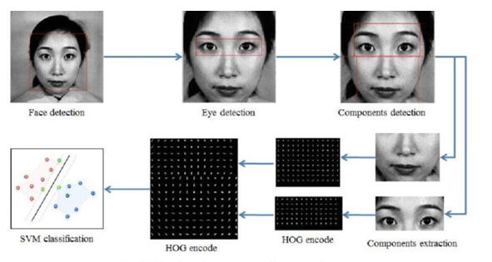
Contd…
Steps:
Data Collection: Capture images of people to create a dataset of faces.
Preprocessing: Resize, convert images to grayscale, and detect faces.
Face Recognition Model: Use machine learning models (SVM, CNN) or pre-trained models (FaceNet) for face matching.
Attendance Logging: Log the detected faces in a database or an Excel sheet.
Figure : Combination of HOG and SVM

Slide 32
Contd…
# Importing necessary libraries
import cv2
import face_recognition
import numpy as np
import pandas as pd
from datetime import datetime
# Initialize the webcam
video_capture = cv2.VideoCapture(0)
# Load images and encode faces
known_face_encodings = []
known_face_names = []

Slide 33
Contd…
# Load a sample image and encode it
def load_known_faces():
image = face_recognition.load_image_file("known_person.jpg")
encoding = face_recognition.face_encodings(image)[0]
known_face_encodings.append(encoding)
known_face_names.append("Person Name")
# Capture the image and detect faces in real-time
def recognize_faces(frame):
# Convert image to RGB
rgb_frame = frame[:, :, ::-1]

Slide 34
Contd…
# Find all face locations and encodings
face_locations = face_recognition.face_locations(rgb_frame)
face_encodings = face_recognition.face_encodings(rgb_frame, face_locations)
return face_locations, face_encodings
# Mark attendance
def mark_attendance(name):
with open("attendance.csv", "a") as f:
now = datetime.now()
current_time = now.strftime("%Y-%m-%d %H:%M:%S")
f.write(f"{name},{current_time}\n")

Slide 35
Contd…
# Main program to start the webcam and check attendance
load_known_faces()
while True:
ret, frame = video_capture.read()
face_locations, face_encodings = face_recognition.face_locations(frame), face_recognition.face_encodings(frame, face_locations)
for (top, right, bottom, left), face_encoding in zip(face_locations, face_encodings):
matches = face_recognition.compare_faces(known_face_encodings, face_encoding)
name = known_face_names[matches.index(True)] if True in matches else "Unknown"
if name != "Unknown":
mark_attendance(name)

Slide 36
Contd…
cv2.rectangle(frame, (left, top), (right, bottom), (0, 0, 255), 2)
cv2.putText(frame, name, (left, top - 10), cv2.FONT_HERSHEY_SIMPLEX, 0.9, (255, 255, 255), 2)
cv2.imshow('Video', frame)
if cv2.waitKey(1) & 0xFF == ord('q'):
break
# Release the camera and close the window
video_capture.release()
cv2.destroyAllWindows()

Slide 37
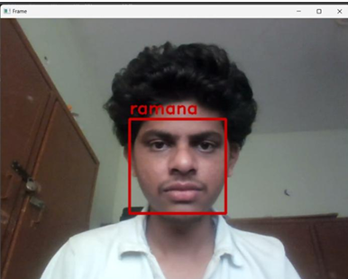
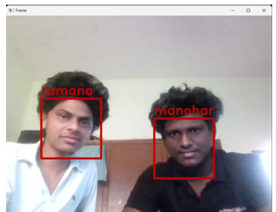
Result
The attendance system captures images using a camera, detects faces (single or multiple), and applies face recognition algorithms like ResNet34 or HOG. It compares detected faces with a pre-stored database and logs attendance in an Excel sheet with names, timestamps, and dates. Unmatched faces are skipped or marked as "No Match.“
Figure : Single Face Dectection Figure : Multiple Face Dectection

Slide 38
Research Paper
research paper

Slide 39
Conclusion
The Face Recognition-Based Attendance System offers an innovative and efficient solution for automating attendance management. By leveraging advanced technologies like computer vision and machine learning, the system captures and recognizes individuals' faces in real-time using cameras. It eliminates the issues of manual attendance processes such as proxy attendance and errors, ensuring accurate, fast, and contactless attendance marking. The system stores attendance data securely and updates it automatically, providing an organized and efficient method for tracking attendance. Its modular and scalable architecture allows for easy integration with other platforms, making it an ideal solution for educational institutions and workplaces.

Slide 40
References
[1] P. Viola and M. Jones, “Robust Real-Time Face Detection,” International Journal of Computer Vision, vol. 57, no. 2, pp. 137–154, 2004.
[2] D. R. Schneiderman and T. Kanade, "A Robust Algorithm for Detecting Faces in Real-World Images," IEEE Transactions on Pattern Analysis and Machine Intelligence, vol. 24, no. 7, pp. 891–900, July 2002.
[3] F. Zhang, “A Review of Face Recognition Technology and Its Applications in Surveillance Systems,” International Journal of Computer Applications, vol. 48, no. 7, pp. 44–49, 2012.
[4] L. S. Oliveira, P. T. Rodrigues, and M. J. Neves, "Face Recognition Systems: A Survey," International Journal of Computer Science and Engineering, vol. 6, no. 9, pp. 2345–2352, 2013.
[5] H. T. Hu and Y. J. Xu, "A Face Recognition Attendance System Based on OpenCV," Proceedings of the International Conference on Information and Automation, pp. 1-5, 2015.

Slide 41
Thank You!!!

